Slide 1
Proposition 35
Callan Hendershott & Jack Haddon

Slide 2
Parallelograms which are on the same base and in the same parallels equal one another.
*Note: When Euclid says that the two are “equal,” he is referring to the two areas.

Slide 3
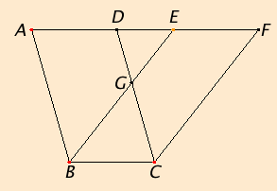
Givens
parallelogram ABCD and EBCF
share the side BC
sides AD and EF are on the same line, but do NOT overlap
AF is parallel to BC by definition of the parallelogram

Slide 4
AD = BC
BC = EF
(Prop 34)
AD = EF
(CN 1)

Slide 5
AD + DE = EF + DE
AE = DF
(CN 2)

Slide 6
< EAB = < FDC
(Prop 29)
Triangle EAB = Triangle FDC
(Prop 4)

Slide 7
Triangle EAB - Triangle DGE = Triangle FDC - Triangle DGE
Quad ABGD = Quad EGCF
(CN 3)

Slide 8
Quad ABGD + Triangle GBC = Quad EGCF + Triangle GBC
Therefore: Parallelogram ABCD = Parallelogram EBCF
(CN 2)

Slide 9
A note on 35
Euclid’s proof for Proposition 35 only works in a particular case. If the sides AD and EF of the original diagram (below) overlap, the areas of the parallelograms cannot be sliced up in the same way. Thus, different steps would need to be taken to prove the two are equal.

Slide 10
Proposition 36
“Parallelograms which are on equal bases and in the same parallels equal one
another.”
This is a generalization of Proposition 35 because it states that the parallelograms will have equal areas (or “be equal”) if they simply have the same base lengths and parallels -- the two do not need to necessarily share a base.
The proof of 36 relies on that of 35.

